Slide 1
MODULE 1
Course Title: Electricity & Magnetism
Course Code: PHYS 102 Unit: 3 CU Lecturer: ABUBAKAR ABDULKADIR

Slide 2
Outline
DC Circuits Theory
Current Voltage and Resistance

Slide 3
DC Circuit
After completing this section you should be able to:
Explain a simple electrical circuit and its components
DC Circuit Theory
Calculate values for current (I), quantity of charge (Q) or time (t) using the equation I=Q/t .
Ohms law
Kirchhoff's Law
Describe how the electrical current in a circuit is related to the voltage applied to the circuit and it's resistance.
Calculate values for current (I), voltage (V) or resistance (R) using Ohm's law.

Slide 4
Electrical Circuit
Objectives
Learn to define what an Electric Circuit is.
Explain the basic components of an electric circuit
Discover the types of electric circuits.
How Do Electric Circuits Work?
Explain what electrical current is.
Explain what is meant by the terms charge and charged particle.
Measurement of current

Slide 5
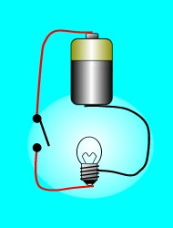
What is an Electric Circuit?
Definition 3 Major Components
In electronics, a circuit is a complete circular path or a loop that electricity flows through.
voltage source (to supply energy),
The load (device that uses energy)
a conductive path ways through which the current flow.
Other components
a switch to turn on or off a circuit.
resistors,
capacitors
inductors
A complete or closed circuit is formed when current flows continuously in the circuit. However, any break on the circuit that stops the flow of current creates an open circuit.

Slide 6
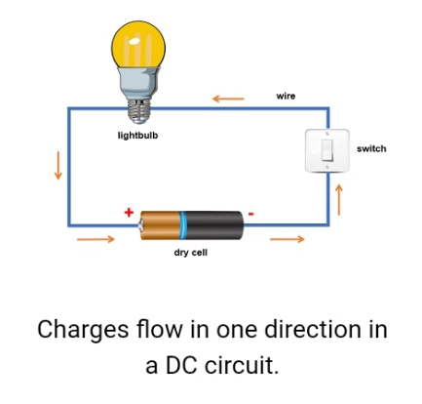
Types of Electric Circuits
Electric circuit are classified based on the direction of current with each one having its advantages and can be used for a specific purpose
DC Circuits (Characteristics)
Current flow in one direction
It is commonly found in low-voltage applications
usually powered by a battery.
A simple circuit containing a light bulb, a switch, and a battery is an example of a DC circuit.
AC Circuits (Characteristics)
Electricity flows back and forth in both directions.
usually switching 60 times a second.

Slide 7
How do Electric Circuits Work?
What happens when the circuit is switched on? (i.e. when the switch is closed.)
Electrons begin to flow around the circuit.
They travel from the negative terminal of the battery to the positive terminal.
Passing through the wires, the switch contacts and the filament of the bulb in the circuit.
When they arrive at the positive terminal of the battery, a chemical reaction, causes the electrons to be transferred through the battery, back to the negative terminal.
This process keeps current flowing through the circuit.
until the battery is discharged, i.e., when all of the chemical energy is used up and the chemical reactions stop.

Slide 8
Electrical Current
What’s electrical current? Measurement of current
An electric current is a flow of particles (electrons) through wires and components.
Electrical current is a measure of the rate at which charge flows around a circuit.
In a closed circuit, every electron (particles) carries a small packet of electrical charge.
A particle which possesses electrical charge is called a charged particle.
Current (I), is a measure of the quantity, of charge, (Q), that passes a point in the circuit, in a time (t) of one second.
The equation of the motion of this charge is given by;
I = Q/t
I current measured in Amps (A).
Q Total charge measured in Coulombs (C).
t is the time taken for the charge, to flow past a point in a circuit, measured in seconds (s).
1 Amp = 1 coulomb per sec, 1A = 1Cs⁻¹.

Slide 9
DC Circuit Theory
D.C. Theory involves the analysis of electrical circuits, consisting of voltage sources (such as batteries), conductors and components called resistors. By the end of the section we should be able to achieve the following objectives;
Objectives
To lean the fundamental nature of voltage, current and resistance.
To state the basic circuit laws (Ohm's Law and Kirchhoff’s law) showing the relationship between voltage, current and resistance.
To Learn techniques for adding resistors together when connected in series or parallel.

Slide 10
Voltage, Current & Resistance
voltage, current and resistance
Resistance of a material
A measure of how well a material resists current flow.
Measured in units called Ohms (Ω).
The copper wires in the circuit will typically have a resistance of less than 1Ω, while the p.v.c insulation, will have a resistance of several Meg-ohms, (M Ω) (millions of ohms).
Voltage (characteristics)
It is the pressure from the power source (battery) of the electric circuit that pushes the electrons (charged particles) through a conducting loop, enabling them to do work such as illuminating a light.
Voltage causes current to flow in an electrical circuit.
The larger the voltage is, then the larger the current will be
Example: A 6V battery will produce more current in the same circuit, than a 1.5V battery would
Current
Already Treated

Slide 11
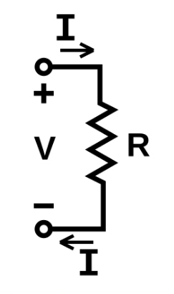
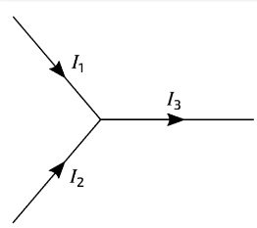
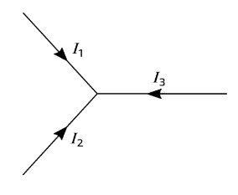
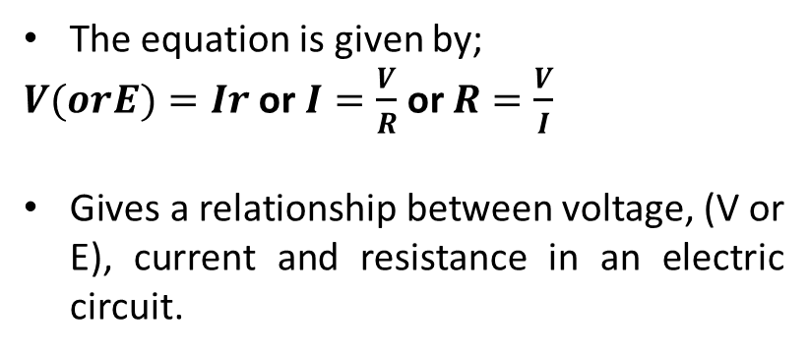
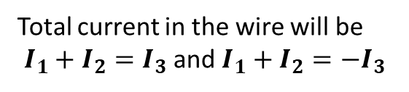
Ohm's Law and Kirchhoff’s law
Ohm's Law Kirchhoff’s law
Statement: the electric current flowing through a conductor(wire) between two points is directly proportional to the voltage across the two points
Current law (1st Law) states that the current flowing into a node ( or a junction) must be equal to the current flowing out of it. This is a consequence of charge conservation.
Total current in the wire will be
$I_{1}+I_{2}=I_{3}$ and $I_{1}+I_{2}={−I}_{3}$
The equation is given by;
$V(orE)=Ir$ or $I=\frac{V}{R}$ or $R=\frac{V}{I}$
Gives a relationship between voltage, (V or E), current and resistance in an electric circuit.
Voltage law (2nd Law) states that in a complete loop within a circuit, the sum of all voltages across components which supply electrical energy ( such as cell or generator) must be equal to the sum of all voltages across the other components in the same loop. This is a consequence of both charge conservation and the conservation of energy.

Slide 12
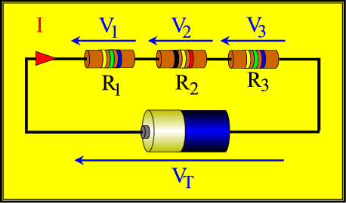

Arrangement of Resistors in Circuits
Series and Parallel arrangement Combined resistance
Resistors in series
According to Kirchhoff’s voltage law, the voltage of the e.m.f. is equal to the sum of the voltage drops across each resistor.
$$V_{T}=V_{1}+V_{2}+V_{3}$$
According to Ohm's law;
$${IR}_{T}={IR}_{1}+{IR}_{2}+{IR}_{3}$$
Therefore the combined resistance will be;
$$R_{T}=R_{1}+R_{2}+R_{3}$$
Generally, for n resistors we can write;
$$R_{T}=R_{1}+R_{2}+R_{3}+…R_{n}$$
When resistors are connected end to end they are said to be in series.
the current passing through resistor is same
the p.d across each resistor is different

Slide 13
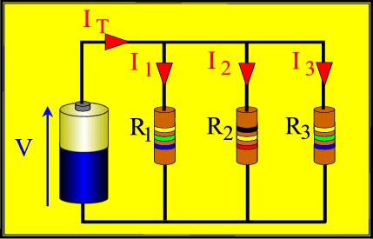

Cont…
Series and Parallel arrangement Combined resistance
Resistors in Parallel
According to Kirchhoff’s current law, the sum of the currents flowing out of the junction (and through each resistor), is equal to the current flowing into the junction.
$$I_{T}=I_{1}+I_{2}+I_{3}$$
According to Ohm's law;
$$\frac{V}{R_{T}}=\frac{V}{R_{1}}+\frac{V}{R_{2}}+\frac{V}{R_{3}}$$
Therefore the combined resistance will be;
$$\frac{1}{R_{T}}=\frac{1}{R_{1}}+\frac{1}{R_{2}}+\frac{1}{R_{3}}$$
When resistors are connected side by side so that their corresponding ends meet at two common points, they are said to be in parallel.
the p.d across the resistors is the same but the current through each resistor is different

